Slide 1

18CSC205J Operating Systems
UNIT I
Course Learning Rationale
Introduce the key role of an Operating System
Insist the Process Management functions of an Operating System
Course Learning Outcomes
Identify the need of an Operating system
Know the Process management functions of an Operating system
Learning Resources
Abraham Silberschatz, Peter Baer Galvin, Greg Gagne, Operating systems, 9th ed., John Wiley & Sons, 2013
William Stallings, Operating Systems-Internals and Design Principles, 7th ed., Prentice Hall, 2012
Andrew S.Tanenbaum, Herbert Bos, Modern Operating systems, 4th ed., Pearson, 2015
Bryant O‟Hallaxn, Computer systems- A Programmer‟s Perspective, Pearson, 2015

Slide 2
Contents
Operating System Objectives and functions
Gaining the role of Operating systems
The evolution of operating system, Major achievement
Understanding the evolution of Operating systems from early batch processing systems to modern complex systems
OS Design considerations for Multiprocessor and Multicore
Understanding the key design issues of Multiprocessor Operating systems and Multicore Operating systems
PROCESS CONCEPT– Processes, PCB
Understanding the Process concept and Maintenance of PCB by OS
Threads – Overview and its Benefits
Understanding the importance of threads
Process Scheduling : Scheduling Queues, Schedulers, Context switch
Understanding basics of Process scheduling
Operations on Process – Process creation, Process termination
Understanding the system calls – fork(),wait(),exit()
Inter Process communication : Shared Memory, Message Passing ,Pipe()
Understanding the need for IPC
PROCESS SYNCHRONIZATION: Background, Critical section Problem
Understanding the race conditions and the need for the Process synchronization

Slide 3
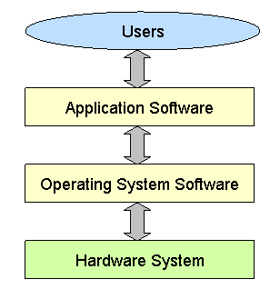
What is operating system?
Definition:
The operating system acts as an Interface between the user and computer hardware
Without an operating system, a computer would be useless
“OS is designed in such a way, that it is convenient to use in an efficient manner”
Courtesy : Abraham Silberschatz, Peter Baer Galvin, Greg Gagne, Operating systems, 9th ed., John Wiley & Sons, 2013
Figure 1. Components of Computer system

Slide 4
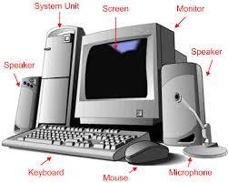

- CPU Central processing unit - Memory - I/O devices
Hardware
Computer Hardware is the physical parts or components of a computer
Software
- Application Programs
Word Processors
Microsoft Office
Computer software or simply software is any set of instructions that directs a computer to perform specific operations.

Slide 5


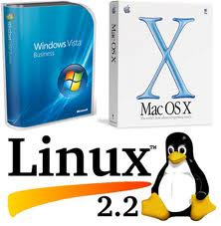

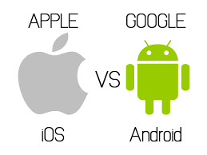

Some Examples of Operating System
Mobile OS

Slide 6
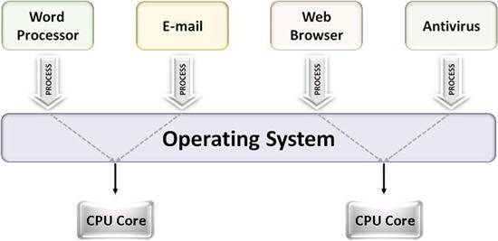
Tasks performed by Operating System
It manages computer hardware
It controls and coordinates the computer H/W
It specifies, how various resources like hardware and software can be used in an efficient manner.
Courtesy : Operating systems : Internals and design principles, 7th ed William Stallings, PHI

Slide 7
Two view points of Operating System
User’s view
Users want → ease of use and good performance & highly convenience
Don’t care about resource utilization
Users can share the terminals, connected to mainframe or minicomputer.
Resources are shared, hence maximum resource utilization is possible.
Individual Users with dedicate systems such as workstations use shared resources from servers or Printers.
In case of hand held devices, the operating system is designed for individual usability. Example: OS on iPhone, or any Android phone.

Slide 8
Two view points of Operating System
System view
The computer system, need to consider CPU time, memory, I/O Devices.
Hence,
OS is a resource allocator
Manages all resources
Conflicting requests between resources are managed for efficient use
OS is a control program
Controls execution of programs to prevent errors and improper use of the computer

Slide 9
Objectives of Operating system
Convenience
Efficiency
Ability to evolve
It specifies how resources are convenient to use in an efficient manner.
Note:
The Operating system is like a government. It does not perform any useful function by itself.

Slide 10
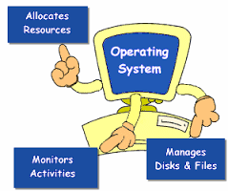
Functions of Operating system
OS as a service routine
Program development.
Ex: Editors & Debuggers
Program Execution
Access I/O devices and controlling access to I/O devices
Error detection & response
Performance maintenance

Slide 11
Role of Operating System
OS as a
User/Computer Interface
Computer Hardware-Software Structure
Operating System as a Software
Functions in the same way as ordinary computer software
Operating System as a Resource Manager
A computer is a set of resources for moving, storing, & processing data
Layered organization
OS services to users
Program, or suite of programs, executed by the processor
Frequently relinquishes control and must depend on the processor to allow it to regain control
The OS is responsible for managing these resources
The OS exercises its control through software
Courtesy : Abraham Silberschatz, Peter Baer Galvin, Greg Gagne, Operating systems, 9th ed., John Wiley & Sons, 2013

Slide 12
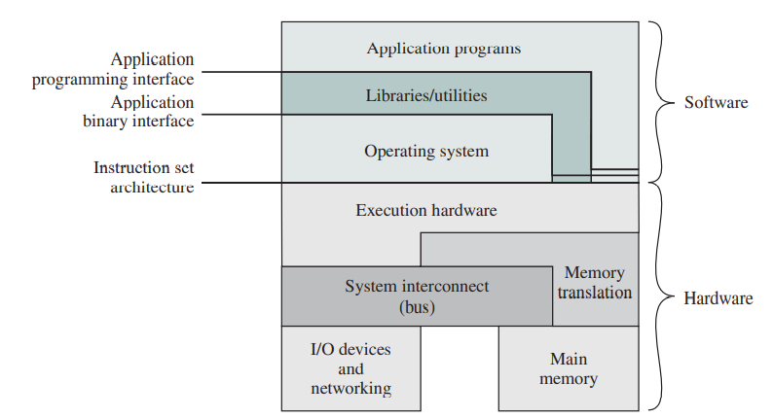
The OS as a User/Computer Interface
OS provides services in following areas
Program development
Program execution
Access to I/O devices
Controlled Access to files
Error detection and response
System access
Accounting
Instruction Set Architecture(ISA)
Application Binary Interface (ABI)
Application Programming Interface(API)
Computer Hardware & Software Structure
Courtesy : Operating systems : Internals and design principles, 7th ed William Stallings, PHI

Slide 13
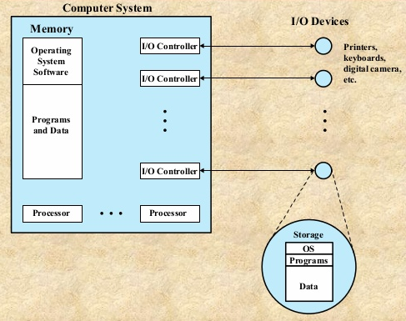
The Operating System as a Resource Manager
OS is responsible for managing resources for movement, storage, processing and control.
By managing OS is controller of these resources
OS has control mechanism which is unusual in two aspects
OS functions in same way as ordinary computer software, i.e it’s a program or s/w suit of programs executed by processor
The OS frequently relinquish the control and depends on the processor to regain the control
OS as Resource Manager
Figure shows main resources managed by OS
Courtesy : Operating systems : Internals and design principles, 7th ed William Stallings, PHI

Slide 14
So, how OS differs form other computer programs ??
It directs the processor in use of other system resources’
It makes processor to coordinate and work with other resources
If processor wants to do any other program it cease the execution of OS program and do
Then OS relinquish the control and prepare processor to do next useful task
The (Ref Figure) part of OS remains in main memory known as Kernal/nucleus , which contains most frequently used programs.
The user program and data are also available in mainmemory
The memory management Hardware (in the processor) and OS jointly controls the memory allocations
The os decides when and I/O devices and files can be used by the user programs and controls the access accordingly.
Courtesy : Operating systems : Internals and design principles, 7th ed William Stallings, PHI

Slide 15
The Evolution of Operating System
Serial Processing
Late 1940 to mid 1950
Simple Batch System
Multiprogrammed Batch System
Time-Sharing System 1961
Compatible Time Sharing System (CTSS)-MIT
Mid 1950, by General Motors to use on IBM701
Early 1960 IBMSYS an IBM Batch Processing OS Influenced other os
Memory is shared among different subsystems, although only one can be executed at a time.

Slide 16
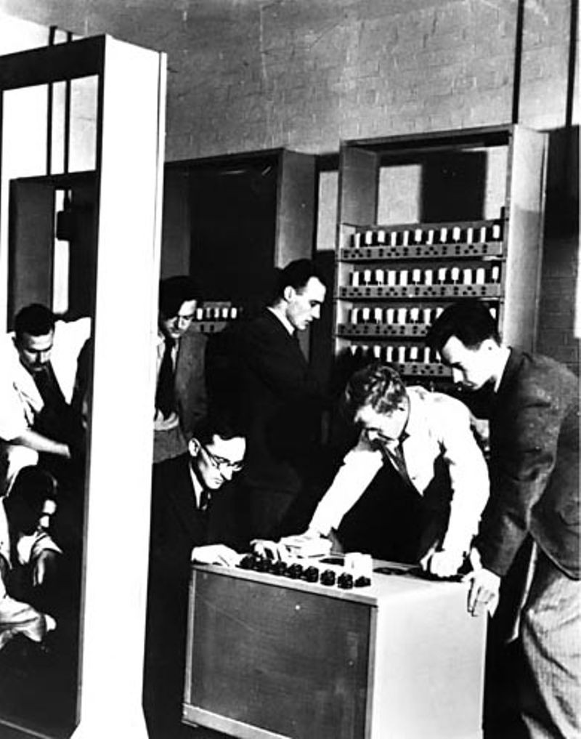
Serial Processing (Late 1940 and Mid 1950)
No Operating System
Programmers interacted Straight away with hardware
Lights, toggles, input devices and printers
Inputs are given through input devices (card readers), errors are intimated through lights and normal completion is done through printers
These systems had two problems
Scheduling
Used hard copy sign-off sheets for reserving computing time (multiples of 30 minutes)
User block 2 slots and use only 45 min
User block 2 slots and unable complete within it
Setup time
Single program (Job) need to load compiler and source program in to the memory
Later save the compiled program and then loading and linking
All these steps cards are to be mounted and unmounted in sequence
Failing in any of these steps needs repetition of entire steps
Later there were many System software developed to make this process efficient however these process are done one after another
Under/Over utilization

Slide 17
Simple Batch Systems
Executes jobs in batch controlled by Monitors
User submits jobs to the operator, who make them it to batches loads the tape in to input.
Jobs branch back to monitor, which loads another batch of jobs
Batch system can be seen in two views

Slide 18
Simple Batch Systems
Monitor Point of View | Processor Point of View
Controls sequence of events Partially Resides on main memory for execution – Called Resident Monitor Rest is loaded as subroutine in user program It reads the jobs at once ( from card/tape)and loaded in to user program area , control passed to user job Once completed user program transfer the control to monitor, Monitor starts to read next batch Results are sent to Output devices | At a point in time Current batch programs executed in main memory On completion (sent control to monitor) brings next batch get loaded in another portion in user area Once loaded, job gains control and execute the instructions This continues util end of program or error Process gains control means- processor executes the current program instructions.

Slide 19
Simple Batch System..
Monitor performs scheduling of batches & improves job setup time
The program instruction are given to the monitor using special language called Job Control Language(JCL)
Eg: Program is written in FORTRAN, the program & data is fed in a separate card, in addition to this job is described using JCL
JCL →Special type of programming language used to provide instructions to the monitor
what compiler to use
what data to use
Monitor Reads $FTN and loads appropriate language compiler
Compiler translates the source/User program into object code
Object code is stores in Memory / Mass Storage
If stored in Mass storage Monitor executes “Compile, Load, Go” instructions, if on Memory $LOAD instruction is required
JCL (Executed by Monitor)
$JOB
$FTN
FORTRON Instruction
$LOAD
$RUN
PROGRAM DATA
$END
The Input instruction read a line of data and invoke input routine which is part of OS
The user programs makes sures that is does not call JCL inst
At compilation time monitor scan input line until next JCL inst to make ensure there is no too large / too low data lines

Slide 20
Simple Batch System..
Monitor
Interrupt Processing
Device drivers
Job Sequencing
Control language Interpreter
User Program Area
User Mode : Executes user program
Kernel mode/Monitor Mode : Executes Privileged Instruction
Modes in Batch Processing
Boundary

Slide 21
Simple Batch System..
The hardware features by monitors (Apart from fetching inst, seize and relinquish control)
Memory Protection :
When user program in under execution the it must not attempt to access the other users memory area, if so the processor Hardware detects is as error and transfers the control to the monitor. Monitor aborts the job with an error message and takes up a next job
Timer :
To avoid job monopolising the processor, it sets timer at the beginning of job, if timer expires user job is stopped and control transferred to the monitor
Privileged Instructions:
Few special/ Privileged instructions are executed under monitor mode, if such instructions are happened to attempted by user, then control is transferred to monitor. All I/O instructions are Privileged instructions, which prevents the user programs from reading the Job control instructions
Interrupts
This facilitates the OS in relinquish control and regaining control from user programs
Limitations
Thought it is advantageous than serial processing, it often requires same process done by the programmer in batches.

Slide 22
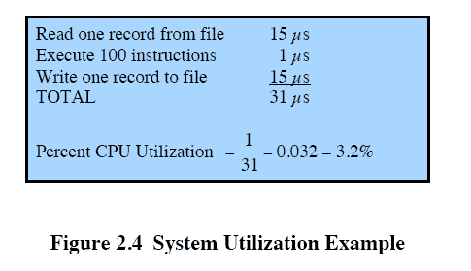
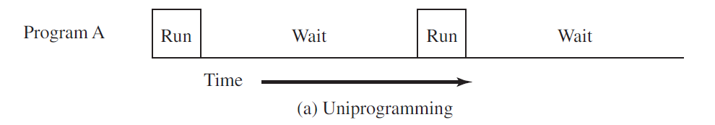
Multiprogrammed Batch Systems
In batch processing system, memory holds resident monitor (OS) and one user program
Batch processing hold Processor on idle state when I/O operations are being done.
If the memory is sufficiently large to hold more than one user program then, while one program is getting I/O , processor can be switched to another program, this is called as Multiprogramming/ Multitasking.
Courtesy : Operating systems : Internals and design principles, 7th ed William Stallings, PHI

Slide 23
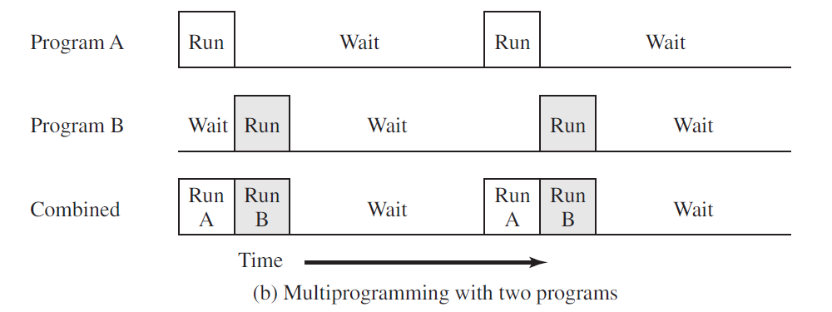
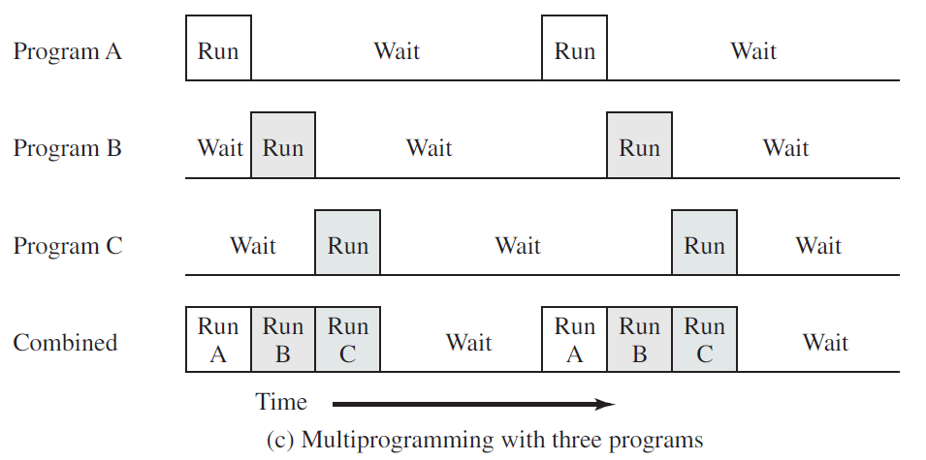
Courtesy : Operating systems : Internals and design principles, 7th ed William Stallings, PHI

Slide 24
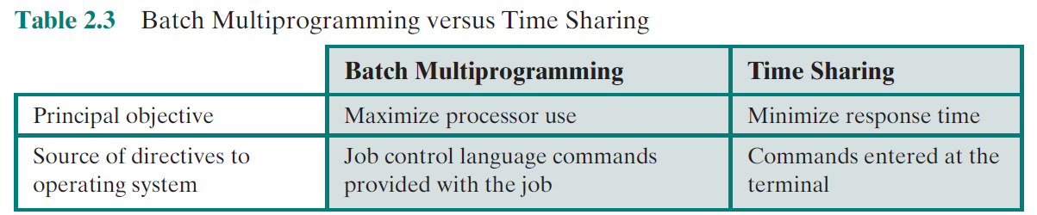
Time-Sharing Systems
In 1960 programs need dedicated computers, which wasn’t possible as it was too costly in those days
Application with more user interactions, needs dedicated computers
Multiprogramming designed to handle multiple interactive jobs referred as time slicing
Used to share processor among multiple user, an makes each user to feel that they have dedicated system but interleaved among all of them.
Hence if n user using the system, then each user see 1/n of effective computer capacity.
Courtesy : Operating systems : Internals and design principles, 7th ed William Stallings, PHI

Slide 25
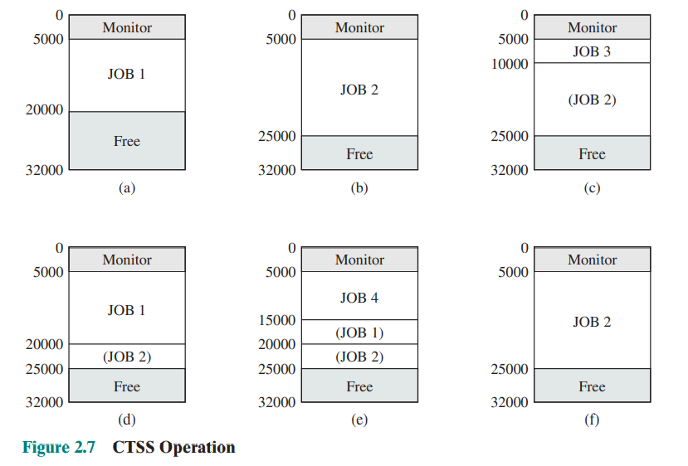
CTSS First Time sharing OS
Resident Monitor: 0-5000 words
User program : 5000- 32000 words timeslice : 0.2 sec
Example :
J1->Job 1: 15000
J2->Job 2: 20000
J3->Job3 : 5000
J4->Job 4: 10000
Job 1 is loaded in the memory,
Job2 is loaded since job2 and 1 can not accommodate together job 1 is flushed out
Job 3 is loaded in memory since job 2 & 3 can accommodate in memory job 2 remains there
Now processor takes job1, only portion of job2 is accommodated in memory
Now the timeslice of j1 is over processor takes J4 so portion of J1 and J2 remains in memory, Now to activate J1 or J2 only partial data is to be loaded.
JOB2 is loaded for completion.
Courtesy : Operating systems : Internals and design principles, 7th ed William Stallings, PHI

Slide 26
Compatible Time-Sharing Systems
CTSS
One of the first time-sharing operating systems
Time Slicing
System clock generates interrupts at a rate of approximately one every 0.2 seconds
Developed at MIT by a group known as Project MAC
Ran on a computer with 32,000 36-bit words of main memory, with the resident monitor consuming 5000 of that
To simplify both the monitor and memory management a program was always loaded to start at the location of the 5000th word
At each interrupt OS regained control and could assign processor to another user
At regular time intervals the current user would be preempted and another user loaded in
Old user programs and data were written out to disk
Old user program code and data were restored in main memory when that program was next given a turn
Courtesy : Operating systems : Internals and design principles, 7th ed William Stallings, PHI
Notes:
One of the first time-sharing operating systems to be developed was the
Compatible Time-Sharing System (CTSS) [CORB62], developed at MIT by a
group known as Project MAC (Machine-Aided Cognition, or Multiple-Access
Computers). The system was first developed for the IBM 709 in 1961 and later
transferred to an IBM 7094.
Compared to later systems, CTSS is primitive. The system ran on a computer
with 32,000 36-bit words of main memory, with the resident monitor consuming 5000
of that. When control was to be assigned to an interactive user, the user’s program
and data were loaded into the remaining 27,000 words of main memory. A program
was always loaded to start at the location of the 5000th word; this simplified
both the monitor and memory management. A system clock generated interrupts
at a rate of approximately one every 0.2 seconds. At each clock interrupt, the OS
regained control and could assign the processor to another user. This technique is
known as time slicing . Thus, at regular time intervals, the current user would be
preempted and another user loaded in. To preserve the old user program status for
later resumption, the old user programs and data were written out to disk before the
new user programs and data were read in. Subsequently, the old user program code
and data were restored in main memory when that program was next given a turn.

Slide 27
MAJOR ACHIEVEMENTS
Operating Systems are among the most complex pieces of software ever developed.
Four major theoretical advances in the development of operating systems:
Process
Memory management
Information protection and security
Scheduling and resource management

Slide 28
MAJOR ACHIEVEMENTS-The Process
Central to the design of operating systems is the concept of process.
Three major lines (Multiprogramming batch operation , Time sharing & Real time transaction systems ) of computer system development created problems in timing and synchronization that contributed to the development of concept of the process:
Four main course of error
1) Improper Synchronization
2) Failed mutual exclusion
3) Nondeterministic program operation
4) Deadlocks
Process consisting of three components:
An executable program
The associated data needed by the program
The execution context of the program

Slide 29
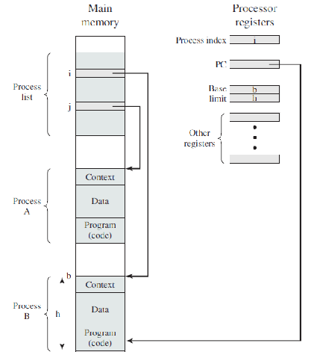
The Process…
The execution context, or process state is the internal data by which the OS is able to supervise and control the process.
This internal information is separated from the process, because the OS has information not permitted to the process
Fig.1 indicates a way in which processes may be managed. Two processes, a and B, exist in portions of main memory.
The process list contains one entry for each process, which includes a pointer to the location of the block of memory that contains the process.
The entry may also include part or all of the execution context of the process.
Fig.1 Typical process Implementation
Courtesy :William Stallings, Operating Systems-Internals and Design Principles, 7th ed., Prentice Hall, 2012

Slide 30
The Process…
The remainder of the execution context is stored elsewhere, perhaps with the process itself or frequently in a separate region of memory.
The process index register contains the index into the process list of the process currently controlling the processor.
The program counter points to the next instruction in that process to be executed.
The base and limit registers define the region in memory occupied by the process.

Slide 31
MAJOR ACHIEVEMENTS - Memory Management
Memory Mangement
Memory management is the functionality of an operating system which handles or manages primary memory and moves processes back and forth between main memory and disk during execution.

Slide 32
MAJOR ACHIEVEMENTS - Memory Management
Memory Management
Main Memory
Virtual Memory
Main Memory
It is used to store instructions and process data.
The memory comprises a large array or group of words or bytes, each with its own location.
The primary motive of a computer system is to execute programs.

Slide 33
MAJOR ACHIEVEMENTS - Memory Management
Main Memory
The needs of users can be met by a computing environment that supports modular programming and the flexible use of data.
System managers need efficient and orderly control of storage allocation.
The OS, to satisfy these requirements, has five principal storage management responsibilities:
Typically, operating system meet these requirements with virtual memory and file system facilities.
process isolation
long-term storage
protection and access control
support of modular programming
automatic allocation and management

Slide 34
Virtual Memory
Virtual memory is a facility that allows programs to address memory from a logical point of view, without regard to the amount of main memory physically available.
Paging systems were introduced, which allow Processes to be comprised of a number of fixed size blocks, called pages.
A program references a word by means of a virtual address consisting of a page number and an offset within the page.
The paging system provides for a dynamic mapping between the virtual address used in the program and a real address, or physical address, in main memory. Fig 2. represents virtual memory addressing.

Slide 35
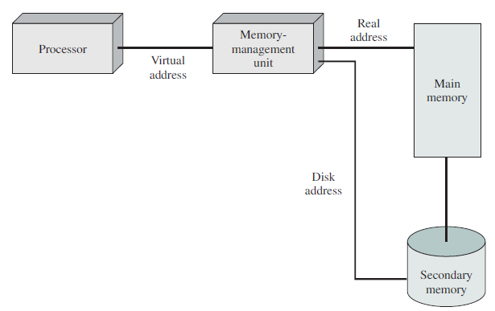
Memory Management…
Paging Concepts
Virtual memory addressing
Courtesy : Operating systems : Internals and design principles, 7th ed William Stallings, PHI

Slide 36
MAJOR ACHIEVEMENTS - Information Protection and Security
The growth in the use of time-sharing systems and, more recently, computer networks has brought with it a growth in concern for the protection of information.
Much of the work in security and protection as it relates to operating systems can be roughly grouped into four categories:
Availability
Confidentiality
Data Integrity
Authenticity

Slide 37
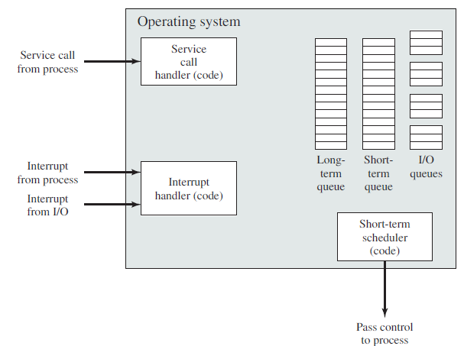
MAJOR ACHIEVEMENTS- Scheduling and Resource Management
A key responsibility of the OS is to manage the various resources available to it (main memory space, I/O devices, processors) and to schedule their use by the various active processes.
Any resource allocation and scheduling policy must consider three factors:
Figure suggests the major elements of the OS involved in the scheduling of processes and the allocation of resources in a multiprogramming environment.
fairness
differential responsiveness
efficiency
Key elements of an operating system for multiprogramming
Courtesy : Operating systems : Internals and design principles, 7th ed William Stallings, PHI

Slide 38
Understanding the evolution of Operating systems from early batch processing systems to modern complex systems
Different approaches and design elements have been tried:
microkernel architecture
multithreading
symmetric multiprocessing
distributed operating systems
object-oriented design

Slide 39
Understanding the evolution of Operating systems from early batch processing systems to modern complex systems
microkernel architecture
Assigns only a few essential functions to the kernel:
The approach:
address spaces
interprocess communication (IPC)
basic scheduling
simplifies implementation
provides flexibility
is well suited to a distributed environment

Slide 40
Understanding the evolution of Operating systems from early batch processing systems to modern complex systems
multithreading
Technique in which a process, executing an application, is divided into threads that can run concurrently
Thread
dispatchable unit of work
includes a processor context and its own data area to enable subroutine branching
executes sequentially and is interruptible
Process
a collection of one or more threads and associated system resources
programmer has greater control over the modularity of the application and the timing of application related events

Slide 41
Understanding the evolution of Operating systems from early batch processing systems to modern complex systems
symmetric multiprocessing
Term that refers to a computer hardware architecture and also to the OS behavior that exploits that architecture
Several processes can run in parallel
Multiple processors are transparent to the user
these processors share same main memory and I/O facilities
all processors can perform the same functions
The OS takes care of scheduling of threads or processes on individual processors and of synchronization among processors

Slide 42
Understanding the evolution of Operating systems from early batch processing systems to modern complex systems
symmetric multiprocessing - Advantages
Performance
more than one process can be running simultaneously, each on a different processor
Availability
failure of a single process does not halt the system
Incremental Growth
performance of a system can be enhanced by adding an additional processor
Scaling
vendors can offer a range of products based on the number of processors configured in the system

Slide 43
Understanding the evolution of Operating systems from early batch processing systems to modern complex systems
Multiprogramming Vs Multiprocessing

Slide 44
Understanding the evolution of Operating systems from early batch processing systems to modern complex systems
Distributed operating systems Vs Object-Oriented Design
Distributed operating systems
Dos defined as the applications are running on multiple computers linked by communications.
Dos is a model where distributed applications are running on multiple computers, linked by communications.

Slide 45
Understanding the evolution of Operating systems from early batch processing systems to modern complex systems
Distributed operating systems Vs Object-Oriented Design
Distributed operating systems
Object-Oriented Design
Provides the illusion of
a single main memory space
single secondary memory space
unified access facilities
State of the art for distributed operating systems lags that of uniprocessor and SMP operating systems
Used for adding modular extensions to a small kernel
Enables programmers to customize an operating system without disrupting system integrity
Eases the development of distributed tools and full-blown distributed operating systems

Slide 46
OS Design considerations for Multiprocessor and Multicore
A multicore system has a single processor with multiple execution units called cores .
A multiprocessor system has two or more processors.
Courtesy : Operating systems : Internals and design principles, 7th ed William Stallings, PHI

Slide 47
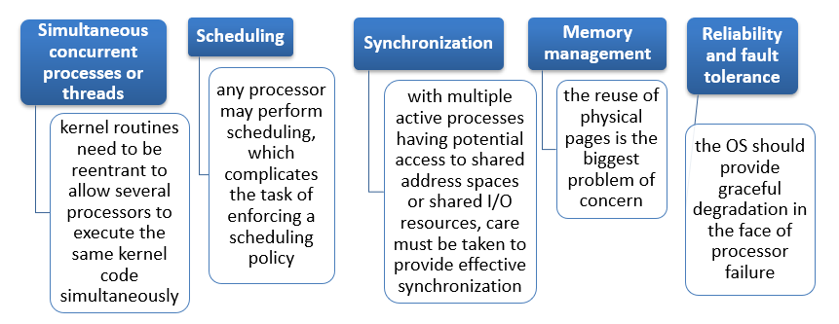
OS Design considerations for Multiprocessor and Multicore
Symmetric Multiprocessor OS Considerations
A multiprocessor OS must provide all the functionality of a multiprogramming system plus additional features to accommodate multiple processors
Key design issues:
Courtesy : Operating systems : Internals and design principles, 7th ed William Stallings, PHI

Slide 48
Multicore OS Considerations
Key design Issues:
The design challenge for a many-core multicore system is to efficiently harness the multicore processing power and intelligently manage the substantial on-chip resources efficiently
Potential for parallelism exists at three levels:
hardware parallelism within each core processor, known as instruction level parallelism
potential for multiprogramming and multithreaded execution within each processor
potential for a single application to execute in concurrent processes or threads across multiple cores
Courtesy : Operating systems : Internals and design principles, 7th ed William Stallings, PHI

Slide 49
Process
Process Concept and States
PCB
Process Scheduling
Operations on Processes
Interprocess Communication
Examples of IPC Systems

Slide 50
Process Concept
An operating system executes a variety of programs:
Batch system – jobs
Time-shared systems – user programs or tasks
Textbook uses the terms job and process almost interchangeably
Process – a program in execution; process execution must progress in sequential fashion
Program is passive entity stored on disk (executable file), process is active
Courtesy : Abraham Silberschatz, Peter Baer Galvin, Greg Gagne, Operating systems, 9th ed., John Wiley & Sons, 2013

Slide 51
Process Concept
Multiple parts
The program code, also called text section
Current activity including program counter, processor registers
Stack containing temporary data
Function parameters, return addresses, local variables
Data section containing global variables
Heap containing memory dynamically allocated during run time
Courtesy : Abraham Silberschatz, Peter Baer Galvin, Greg Gagne, Operating systems, 9th ed., John Wiley & Sons, 2013

Slide 52
Process Concept
Program is passive entity stored on disk (executable file), process is active
Program becomes process when executable file loaded into memory
Execution of program started via GUI mouse clicks, command line entry of its name, etc
One program can be several processes
Consider multiple users executing the same program
Courtesy : Abraham Silberschatz, Peter Baer Galvin, Greg Gagne, Operating systems, 9th ed., John Wiley & Sons, 2013

Slide 53
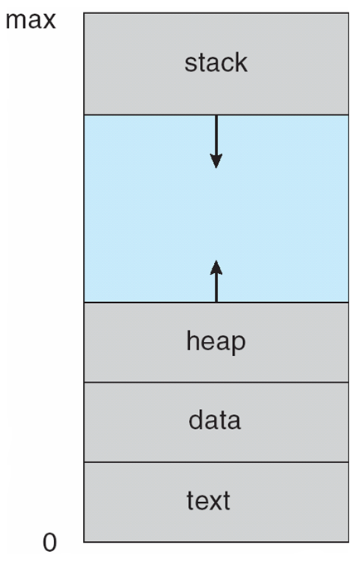
Process in Memory
Courtesy : Abraham Silberschatz, Peter Baer Galvin, Greg Gagne, Operating systems, 9th ed., John Wiley & Sons, 2013

Slide 54
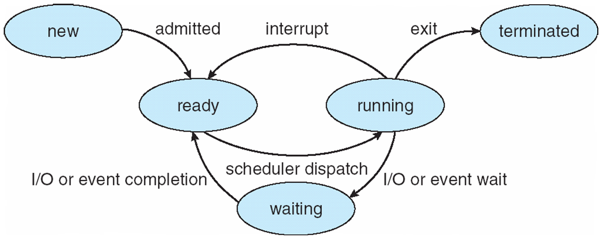
Process State
As a process executes, it changes state
new: The process is being created
running: Instructions are being executed
waiting: The process is waiting for some event to occur
ready: The process is waiting to be assigned to a processor
terminated: The process has finished execution
Courtesy : Abraham Silberschatz, Peter Baer Galvin, Greg Gagne, Operating systems, 9th ed., John Wiley & Sons, 2013

Slide 55
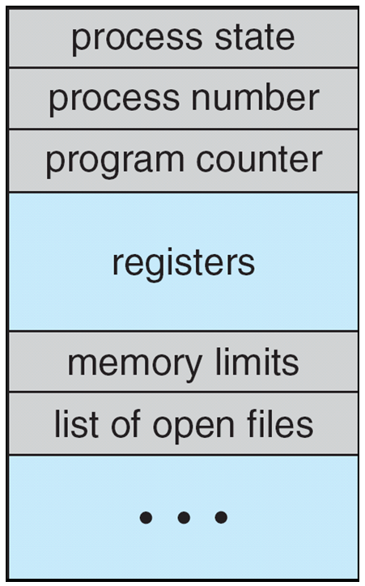
Process Control Block (PCB)
Information associated with each process (also called task control block)
Process state – running, waiting, etc
Program counter – location of instruction to next execute
CPU registers – contents of all process-centric registers
CPU scheduling information- priorities, scheduling queue pointers
Memory-management information – memory allocated to the process
Accounting information – CPU used, clock time elapsed since start, time limits
I/O status information – I/O devices allocated to process, list of open files
Courtesy : Abraham Silberschatz, Peter Baer Galvin, Greg Gagne, Operating systems, 9th ed., John Wiley & Sons, 2013

Slide 56
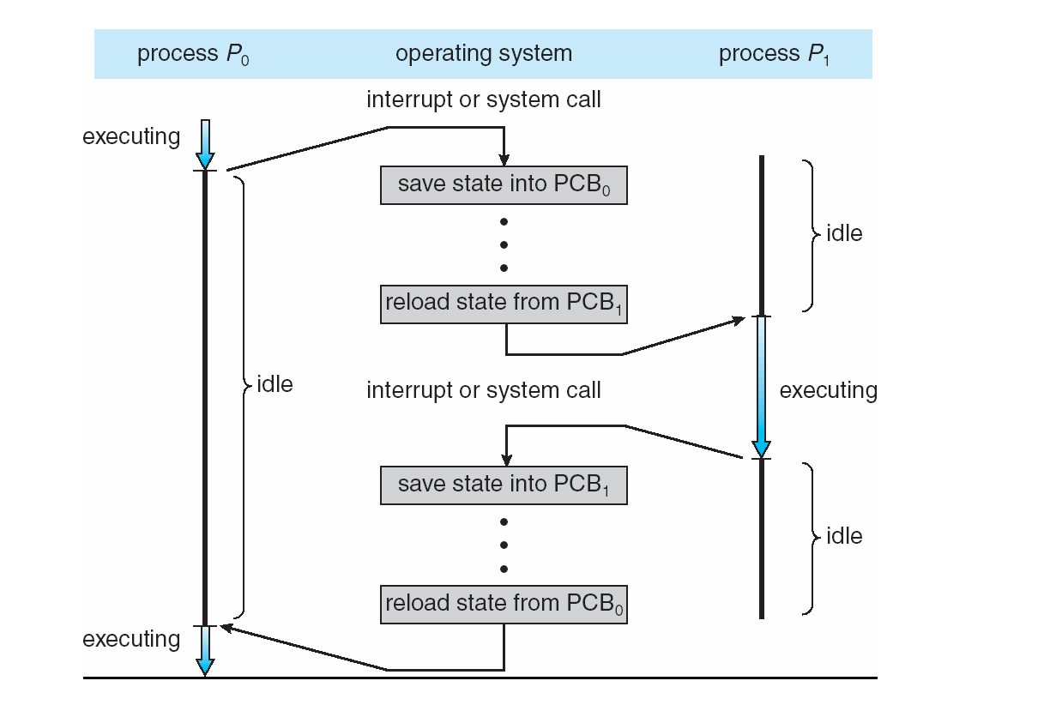
CPU Switch From Process to Process
Courtesy : Abraham Silberschatz, Peter Baer Galvin, Greg Gagne, Operating systems, 9th ed., John Wiley & Sons, 2013

Slide 57
Threads
A thread is a single sequential flow of execution of tasks of a process.
Within a program, a thread is an execution path.
The operating system creates and manages threads, and they share the same memory and resources as the program that created them.
This enables multiple threads to collaborate and work efficiently within a single program.
There can be more than one thread inside a process.
Each thread of the same process makes use of a separate program counter and a stack of activation records and control blocks.
Courtesy : Abraham Silberschatz, Peter Baer Galvin, Greg Gagne, Operating systems, 9th ed., John Wiley & Sons, 2013

Slide 58
Threads
So far, process has a single thread of execution
Consider having multiple program counters per process
Multiple locations can execute at once
Multiple threads of control -> threads
Must then have storage for thread details, multiple program counters in PCB
Courtesy : Abraham Silberschatz, Peter Baer Galvin, Greg Gagne, Operating systems, 9th ed., John Wiley & Sons, 2013

Slide 59
Understanding the importance of threads
On a multiprocessor system, multiple threads can run concurrently on multiple CPUs.
Therefore, multithreaded programs can run much faster than on a uniprocessor system.
They can also be faster than a program using multiple processes, because threads require fewer resources and generate less overhead.
Courtesy : Abraham Silberschatz, Peter Baer Galvin, Greg Gagne, Operating systems, 9th ed., John Wiley & Sons, 2013

Slide 60
Understanding the importance of threads
For example, switching threads in the same process can be faster.
Finally, a major advantage of using threads is that a single multithreaded program will work on a uniprocessor system,
but can naturally take advantage of a multiprocessor system, without recompiling.
Courtesy : Abraham Silberschatz, Peter Baer Galvin, Greg Gagne, Operating systems, 9th ed., John Wiley & Sons, 2013

Slide 61
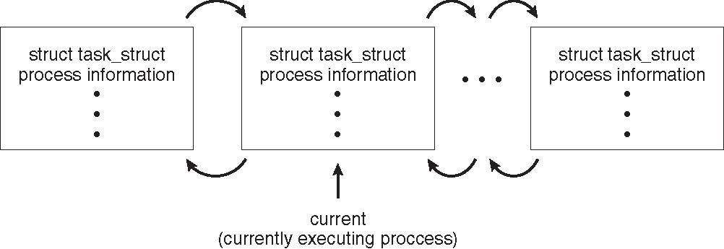
Process Representation in Linux
Represented by the C structure task_struct
pid t_pid; /* process identifier */ long state; /* state of the process */ unsigned int time_slice /* scheduling information */ struct task_struct *parent; /* this process’s parent */ struct list_head children; /* this process’s children */ struct files_struct *files; /* list of open files */ struct mm_struct *mm; /* address space of this process */
Courtesy : Abraham Silberschatz, Peter Baer Galvin, Greg Gagne, Operating systems, 9th ed., John Wiley & Sons, 2013

Slide 62
Process Scheduling
The aim is to assign processes to be executed by the processor or processors over time, in a way that meets system objectives,
Such as response time, throughput, and processor efficiency.
In many systems, this scheduling activity is broken down into three separate functions:
long-, medium-, and short term scheduling
The names suggest the relative time scales with which these functions are performed.

Slide 63
Process Scheduling
Maximize CPU use, quickly switch processes onto CPU for time sharing
Process scheduler selects among available processes for next execution on CPU
Maintains scheduling queues of processes
Job queue – set of all processes in the system
Ready queue – set of all processes residing in main memory, ready and waiting to execute
Device queues – set of processes waiting for an I/O device
Processes migrate among the various queues
Courtesy : Abraham Silberschatz, Peter Baer Galvin, Greg Gagne, Operating systems, 9th ed., John Wiley & Sons, 2013

Slide 64
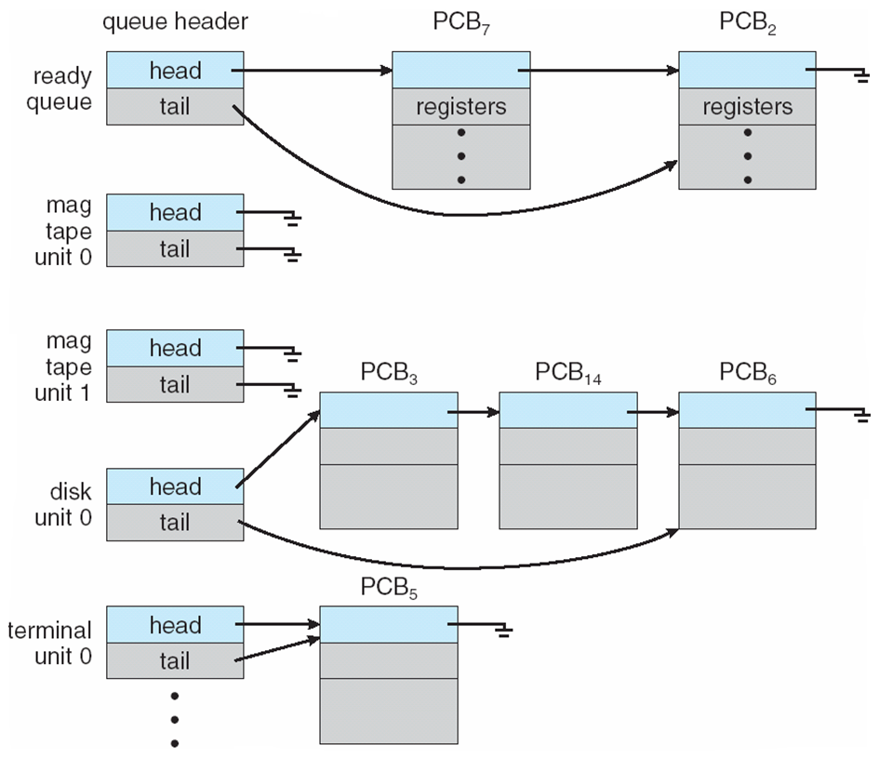
Ready Queue And Various I/O Device Queues
Courtesy : Abraham Silberschatz, Peter Baer Galvin, Greg Gagne, Operating systems, 9th ed., John Wiley & Sons, 2013

Slide 65
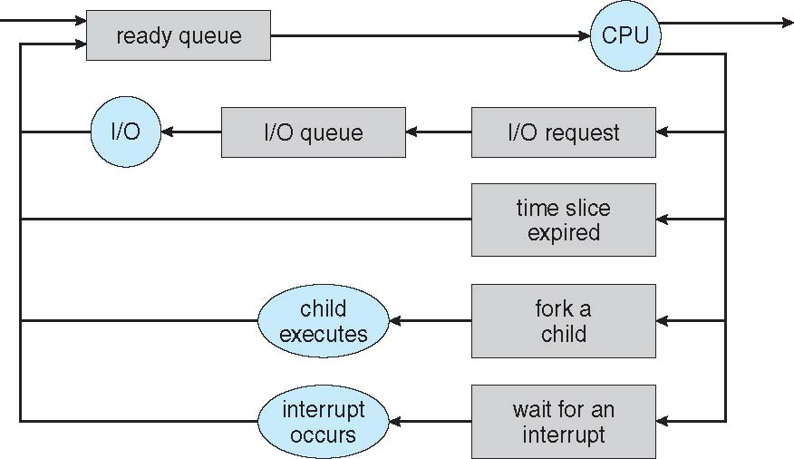
Representation of Process Scheduling
Queueing diagram represents queues, resources, flows
Courtesy : Abraham Silberschatz, Peter Baer Galvin, Greg Gagne, Operating systems, 9th ed., John Wiley & Sons, 2013

Slide 66
Scheduler
A process migrates among the various scheduling queues throughout its lifetime.
The operating system must select, for scheduling purposes, processes from these queues in some fashion.
The selection process is carried out by the appropriate scheduler.

Slide 67
Schedulers
Short-term scheduler (or CPU scheduler) – selects which process should be executed next and allocates CPU
Sometimes the only scheduler in a system
Short-term scheduler is invoked frequently (milliseconds) ⇒ (must be fast)
Long-term scheduler (or job scheduler) – selects which processes should be brought into the ready queue
Long-term scheduler is invoked infrequently (seconds, minutes) ⇒ (may be slow)
The long-term scheduler controls the degree of multiprogramming
Processes can be described as either:
I/O-bound process – spends more time doing I/O than computations, many short CPU bursts
CPU-bound process – spends more time doing computations; few very long CPU bursts
Long-term scheduler strives for good process mix
Courtesy : Abraham Silberschatz, Peter Baer Galvin, Greg Gagne, Operating systems, 9th ed., John Wiley & Sons, 2013

Slide 68
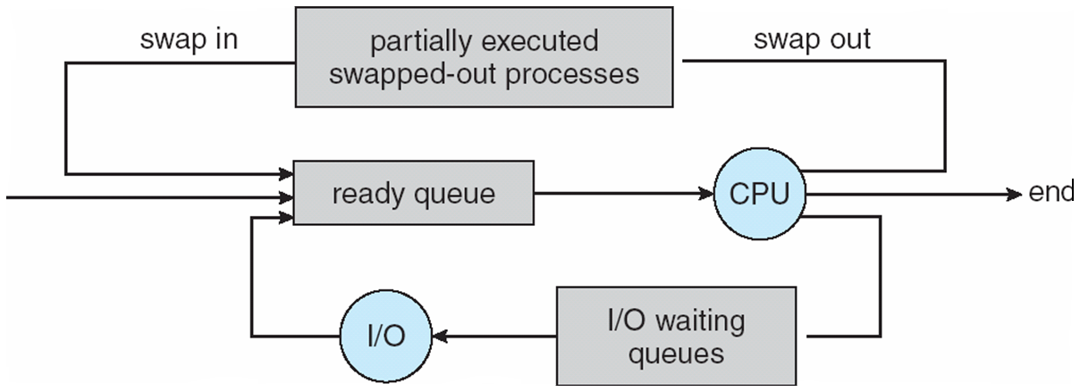
Medium-term scheduler can be added if degree of multiple programming needs to decrease
Remove process from memory, store on disk, bring back in from disk to continue execution: swapping
A part of the swapping function.
Courtesy : Abraham Silberschatz, Peter Baer Galvin, Greg Gagne, Operating systems, 9th ed., John Wiley & Sons, 2013

Slide 69
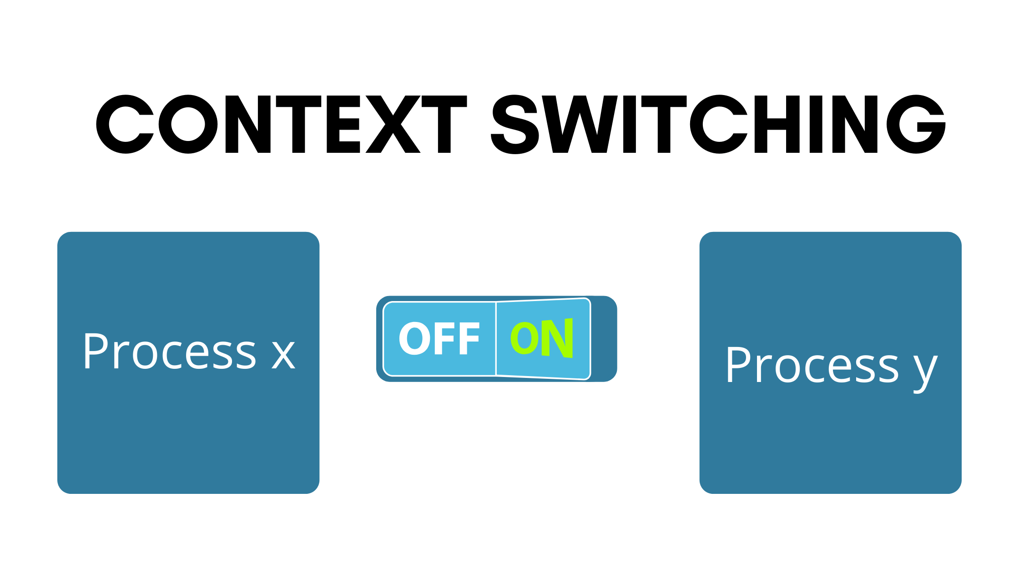
Context Switch
When CPU switches to another process, the system must save the state of the old process and load the saved state for the new process via a context switch
Context of a process represented in the PCB
Context-switch time is overhead; the system does no useful work while switching
The more complex the OS and the PCB ➔ the longer the context switch
Time dependent on hardware support
Some hardware provides multiple sets of registers per CPU ➔ multiple contexts loaded at once
Courtesy:https://i.pinimg.com/originals/73/9f/35/739f35177ddd7985ac7b8e7211f9f3d4.png
Courtesy : Abraham Silberschatz, Peter Baer Galvin, Greg Gagne, Operating systems, 9th ed., John Wiley & Sons, 2013

Slide 70
Operations on Processes
System must provide mechanisms for:
Process Creation
Process Termination
Courtesy : Abraham Silberschatz, Peter Baer Galvin, Greg Gagne, Operating systems, 9th ed., John Wiley & Sons, 2013

Slide 71
Process Creation
Process Creation
Parent process create children processes, which, in turn create other processes, forming a tree of processes
Generally, process identified and managed via a process identifier (pid)
Resource sharing options
Parent and children share all resources
Children share subset of parent’s resources
Parent and child share no resources
Execution options
Parent and children execute concurrently
Parent waits until children terminate
Process tree in Linux

Slide 72
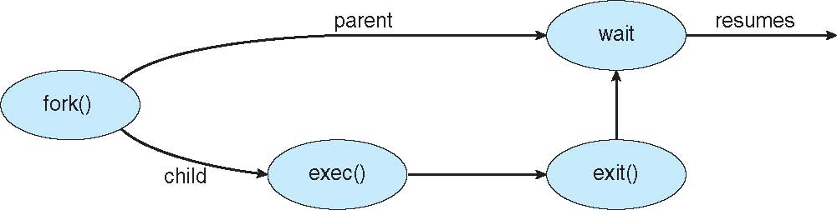
Process Creation
Process Creation
Address space
Child duplicate of parent
Child has a program loaded into it
UNIX examples
fork() system call creates new process
exec() system call used after a fork() to replace the process’ memory space with a new program
A
B
C
D
E
F
G
Note:
execlp() – version of exec()
Parent waits for the child process to complete
When child completes exit(), resumes from wait().
A forks B and C
B forks D and E
C forks F and G
Courtesy : Abraham Silberschatz, Peter Baer Galvin, Greg Gagne, Operating systems, 9th ed., John Wiley & Sons, 2013

Slide 73
Process creation
Process Creation
Steps involved in process creation :
(i). When a new process is created, operating system assigns a unique Process Identifier (PID) to it and inserts a new entry in primary process table.
(ii). Then the required the required memory space for all the elements of process such as program, data and stack is allocated including space for its Process Control Block (PCB).
(iii). Next, the various values in PCB are initialized such as,
Process identification part is filled with PID assigned to it in step (1) and also its parent’s PID.
The processor register values are mostly filled with zeroes, except for the stack pointer and program counter. Stack pointer is filled with the address of stack allocated to it in step (ii) and program counter is filled with the address of its program entry point.
The process state information would be set to ‘New’.
Priority would be lowest by default, but user can specify any priority during creation.
In the beginning, process is not allocated to any I/O devices or files. The user has to request them or if this is a child process it may inherit some resources from its parent.
(iv). Then the operating system will link this process to scheduling queue and the process state would be changed from ‘New’ to ‘Ready’. Now process is competing for the CPU.
(v). Additionally, operating system will create some other data structures such as log files or accounting files to keep track of processes activity.

Slide 74
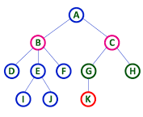
[createprocess()]
Process Creation
Process that create new process (via)
createprocess system call
Creating process → Parent Process
The created process → child
Parent or Children
Parent
Children
Note:
Each process is identified by Process Identifier (PID)

Slide 75
Process Creation
Resource Sharing(CPU time, Memory files, I/O devices)
Parent and children share all resources
Children share subset of parent resources
Parent & child share no resources
Execution
Parent & children execute concurrently
(Asynchronous Process creation)
Parent waits until children terminate
(Synchronous Process creation)
Address Space
Child process, copy the address space of the parent
Child process occupy the separate address space
Note:
When one process creates a new process, the identity of the newly created process is passed to the parent.

Slide 76
Example
Process Creation
Both Parent & Child continue creation of the new process with fork().
Return code of fork() ➔ 0 (Child Process)
Return code of fork() ➔ Non Zero (Parent Process)

Slide 77
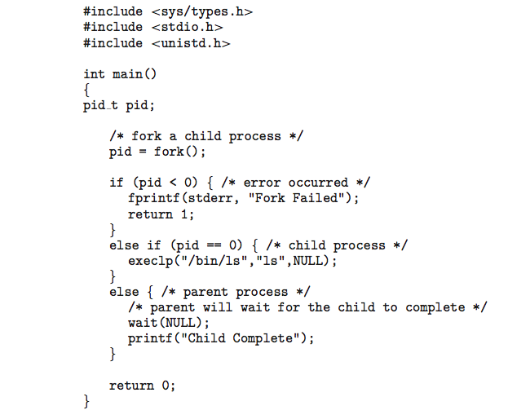
Creating a Separate Process using fork()
Example 2
Example 1
#include <sys/types.h>
#include <studio.h>
#include <unistd.h>
int main()
{
processID pid;
/* create a process */
pid = fork();
if (pid < 0) /* error occurred */
fprintf(stderr, “ERROR");
else if (pid == 0) /* child process */
execlp("/bin/ls", "ls", NULL);
else /* parent process */
/* parent waits for the child to complete */
wait (NULL);
printf ("Child Complete");
}
Courtesy : Abraham Silberschatz, Peter Baer Galvin, Greg Gagne, Operating systems, 9th ed., John Wiley & Sons, 2013

Slide 78
Process Termination
Processes are terminated by themselves when they finish’1 executing their last statement, then operating system USES exit( ) system call to delete its context.
Then all the resources held by that process like physical and virtual memory, 10 buffers, open files etc., are taken back by the operating system. A process P can be terminated either by operation system or by the parent process of P.
A parent may terminate a process due to one of the following reasons,
(i). When task given to the child is not required now.
(ii). When child has taken more resources than its limit.
(iii). The parent of the process is exiting, as a result all its children are deleted. This is called as cascaded termination.

Slide 79
Process Termination
Exit()
Process terminates by itself (ie) when the process finish executing the final statement.
System call: exit()
Returns status data from child to parent (via wait())
Process’ resources are deallocated by operating system
Abort()
The parent process terminating the child process
System call: Terminate Process()
Parent may terminate the execution of children processes using the abort() system call. Some reasons for doing so:
Child has exceeded allocated resources
Task assigned to child is no longer required
The parent is exiting and the operating systems does not allow a child to continue if its parent terminates
Reasons for termination
Child has exceeded allocated resources
Task assigned to child is no longer required
If parent is exiting, some OS doesn’t allow child to process
Cascading termination (2 mark Question)
If the process terminates (either normally or abnormally), then all its children must be terminated.
Kill()
By system admin for administration purpose

Slide 80
Process Termination
Some operating systems do not allow child to exists if its parent has terminated. If a process terminates, then all its children must also be terminated.
cascading termination. All children, grandchildren, etc. are terminated.
The termination is initiated by the operating system.
The parent process may wait for termination of a child process by using the wait()system call. The call returns status information and the pid of the terminated process
pid = wait(&status);
If no parent waiting (did not invoke wait()) process is a zombie
If parent terminated without invoking wait , process is an orphan
Courtesy : Abraham Silberschatz, Peter Baer Galvin, Greg Gagne, Operating systems, 9th ed., John Wiley & Sons, 2013

Slide 81
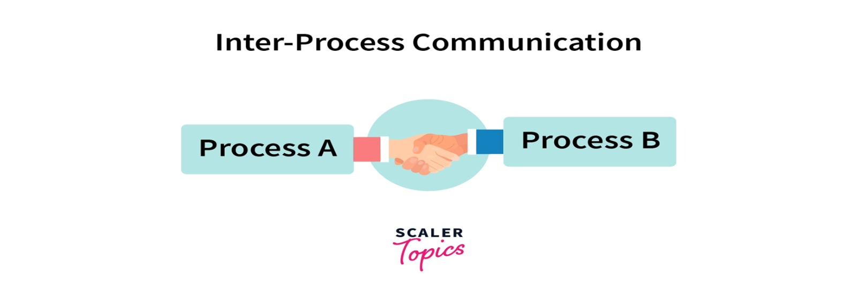
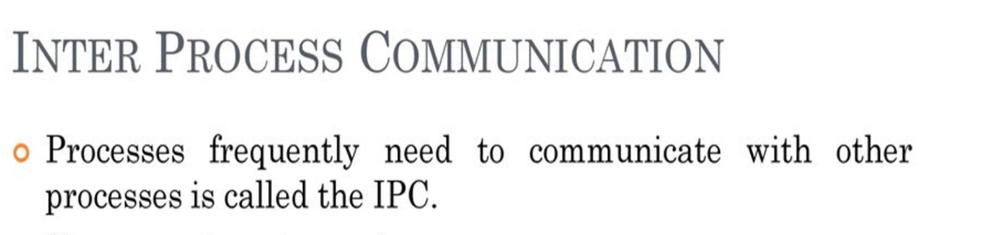
Interprocess Communication

Slide 82
Need for IPC
Processes can execute concurrently
May be interrupted at any time, partially completing execution
Concurrent access to shared data may result in data inconsistency
Maintaining data consistency requires mechanisms to ensure the orderly execution of cooperating processes
Illustration of the problem: Suppose that we wanted to provide a solution to the consumer-producer problem that fills all the buffers. We can do so by having an integer counter that keeps track of the number of full buffers. Initially, counter is set to 0. It is incremented by the producer after it produces a new buffer and is decremented by the consumer after it consumes a buffer.

Slide 83
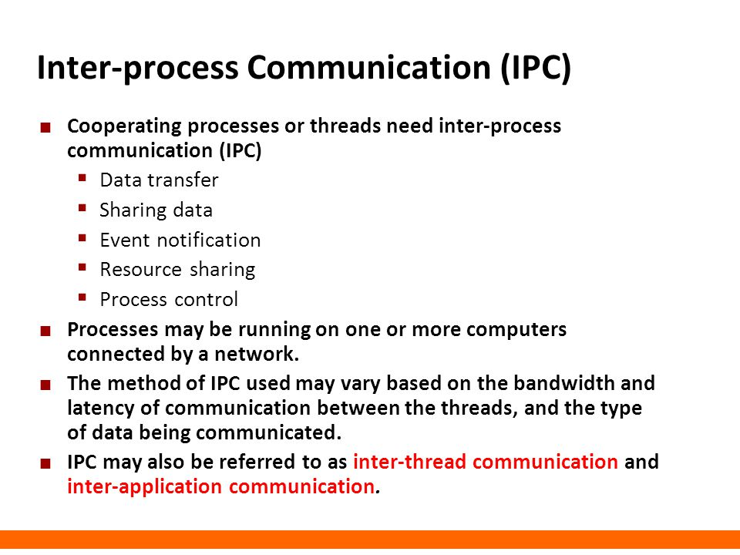
Interprocess Communication

Slide 84
Interprocess Communication
Processes within a system may be independent or cooperating
Cooperating process can affect or be affected by other processes, including sharing data
Cooperating processes need interprocess communication (IPC)
Two models of IPC
Shared memory
Message passing

Slide 85
Communications Models (Modes of IPC)
(a) Message passing. (b) shared memory.
Courtesy : Abraham Silberschatz, Peter Baer Galvin, Greg Gagne, Operating systems, 9th ed., John Wiley & Sons, 2013

Slide 86
Cooperating Processes
Independent process cannot affect or be affected by the execution of another process
Cooperating process can affect or be affected by the execution of another process
Advantages of process cooperation
Information sharing
Computation speed-up
Modularity
Convenience
Courtesy : Abraham Silberschatz, Peter Baer Galvin, Greg Gagne, Operating systems, 9th ed., John Wiley & Sons, 2013

Slide 87
IPC Example - Producer-Consumer Problem
Paradigm for cooperating processes, producer process produces information that is consumed by a consumer process
unbounded-buffer places no practical limit on the size of the buffer
bounded-buffer assumes that there is a fixed buffer size
Bounded-Buffer – Shared-Memory Solution
Shared data
#define BUFFER_SIZE 10
typedef struct {
. . .
} item;
item buffer[BUFFER_SIZE];
int in = 0;
int out = 0;
Solution is correct, but can only use BUFFER_SIZE-1 elements

Slide 88
Bounded-Buffer –Producer
Bounded-Buffer – Consumer
item next_produced;
while (true) {
/* produce an item in next produced */
while (((in + 1) % BUFFER_SIZE) == out)
; /* do nothing */
buffer[in] = next_produced;
in = (in + 1) % BUFFER_SIZE;
}
item next_consumed;
while (true) { while (in == out)
; /* do nothing */ next_consumed = buffer[out];
out = (out + 1) % BUFFER_SIZE;
/* consume the item in next consumed */
}
Courtesy : Abraham Silberschatz, Peter Baer Galvin, Greg Gagne, Operating systems, 9th ed., John Wiley & Sons, 2013

Slide 89
Interprocess Communication – Shared Memory
An area of memory shared among the processes that wish to communicate
The communication is under the control of the users processes not the operating system.
Major issues is to provide mechanism that will allow the user processes to synchronize their actions when they access shared memory.
Synchronization is discussed in great details in Chapter 5.
Courtesy : Abraham Silberschatz, Peter Baer Galvin, Greg Gagne, Operating systems, 9th ed., John Wiley & Sons, 2013

Slide 90
Interprocess Communication – Message Passing
Mechanism for processes to communicate and to synchronize their actions
Message system – processes communicate with each other without resorting to shared variables
IPC facility provides two operations:
send(message)
receive(message)
The message size is either fixed or variable
Courtesy : Abraham Silberschatz, Peter Baer Galvin, Greg Gagne, Operating systems, 9th ed., John Wiley & Sons, 2013

Slide 91
Interprocess Communication – Message Passing
Implementation methods
Direct Communication
Indirect Communication
Synchronization
Buffering
Pipe
Courtesy : Abraham Silberschatz, Peter Baer Galvin, Greg Gagne, Operating systems, 9th ed., John Wiley & Sons, 2013

Slide 92
Message Passing (Cont.)
If processes P and Q wish to communicate, they need to:
Establish a communication link between them
Exchange messages via send/receive
Implementation issues:
How are links established?
Can a link be associated with more than two processes?
How many links can there be between every pair of communicating processes?
What is the capacity of a link?
Is the size of a message that the link can accommodate fixed or variable?
Is a link unidirectional or bi-directional?
Courtesy : Abraham Silberschatz, Peter Baer Galvin, Greg Gagne, Operating systems, 9th ed., John Wiley & Sons, 2013

Slide 93
Message Passing (Cont.)
Implementation of communication link
Physical:
Shared memory
Hardware bus
Network
Logical:
Direct or indirect
Synchronous or asynchronous
Automatic or explicit buffering
Courtesy : Abraham Silberschatz, Peter Baer Galvin, Greg Gagne, Operating systems, 9th ed., John Wiley & Sons, 2013

Slide 94
Naming: Direct Communication
Processes must name each other explicitly:
send (P, message) – send a message to process P
receive(Q, message) – receive a message from process Q
Properties of communication link
Links are established automatically
A link is associated with exactly one pair of communicating processes
Between each pair there exists exactly one link
The link may be unidirectional, but is usually bi-directional
Courtesy : Abraham Silberschatz, Peter Baer Galvin, Greg Gagne, Operating systems, 9th ed., John Wiley & Sons, 2013

Slide 95
Naming: Indirect Communication
Messages are directed and received from mailboxes (also referred to as ports)
Each mailbox has a unique id
Processes can communicate only if they share a mailbox
Properties of communication link
Link established only if processes share a common mailbox
A link may be associated with many processes
Each pair of processes may share several communication links
Link may be unidirectional or bi-directional
Operations
create a new mailbox (port)
send and receive messages through mailbox
destroy a mailbox
Primitives are defined as:
send(A, message) – send a message to mailbox A
receive(A, message) – receive a message from mailbox A
Courtesy : Abraham Silberschatz, Peter Baer Galvin, Greg Gagne, Operating systems, 9th ed., John Wiley & Sons, 2013

Slide 96
Naming: Indirect Communication
Mailbox sharing
P₁, P₂, and P₃ share mailbox A
P₁, sends; P₂ and P₃ receive
Who gets the message?
Solutions
Allow a link to be associated with at most two processes
Allow only one process at a time to execute a receive operation
Allow the system to select arbitrarily the receiver. Sender is notified who the receiver was.
Courtesy : Abraham Silberschatz, Peter Baer Galvin, Greg Gagne, Operating systems, 9th ed., John Wiley & Sons, 2013

Slide 97
Synchronization
Message passing may be either blocking or non-blocking
Blocking is considered synchronous
Blocking send -- the sender is blocked until the message is received
Blocking receive -- the receiver is blocked until a message is available
Non-blocking is considered asynchronous
Non-blocking send -- the sender sends the message and continue
Non-blocking receive -- the receiver receives:
A valid message, or
Null message
Different combinations possible
If both send and receive are blocking, we have a rendezvous
Courtesy : Abraham Silberschatz, Peter Baer Galvin, Greg Gagne, Operating systems, 9th ed., John Wiley & Sons, 2013

Slide 98
Synchronization (Contd)
Producer-consumer becomes trivial
message next_produced;
while (true) { /* produce an item in next produced */
send(next_produced);
}
message next_consumed;
while (true) {
receive(next_consumed);
/* consume the item in next consumed */
}
Courtesy : Abraham Silberschatz, Peter Baer Galvin, Greg Gagne, Operating systems, 9th ed., John Wiley & Sons, 2013

Slide 99
Buffering
Queue of messages attached to the link.
Implemented in one of three ways
1. Zero capacity – no messages are queued on a link. Sender must wait for receiver (rendezvous)
2. Bounded capacity – finite length of n messages Sender must wait if link full
3. Unbounded capacity – infinite length Sender never waits

Slide 100
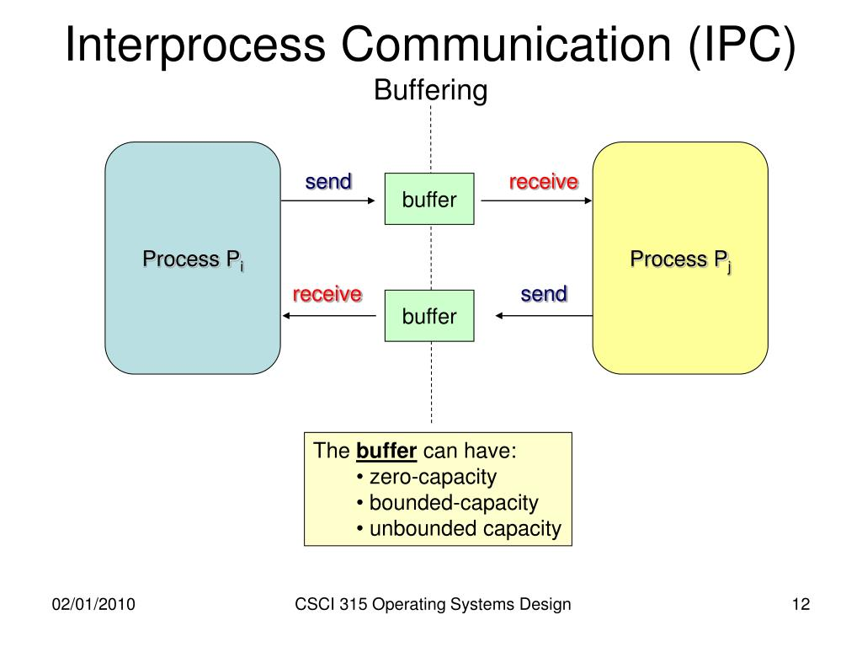
Buffering
Queue of messages attached to the link.
Implemented in one of three ways
1. Zero capacity – no messages are queued on a link. Sender must wait for receiver (rendezvous)
2. Bounded capacity – finite length of n messages Sender must wait if link full
3. Unbounded capacity – infinite length Sender never waits

Slide 101
Pipes
Act as a channel allowing two processes to communicate
One of the first IPC mechanisms in early UNIX systems
Typically provide one of the simpler ways for processes to communicate with one another,
Communication medium between two or more related or interrelated processes.
Either within one process or a communication between the child and the parent processes.
Communication can also be multi-level such as communication between
The parent,
The child and
The grand-child, etc.
Communication is achieved by one process writing into the pipe and other reading from the pipe.
Courtesy : Abraham Silberschatz, Peter Baer Galvin, Greg Gagne, Operating systems, 9th ed., John Wiley & Sons, 2013

Slide 102
Pipes
In implementing a pipe, four issues must be considered:
Is communication unidirectional or bidirectional?
In the case of two-way communication, is it half or full-duplex?
Must there exist a relationship (i.e., parent-child) between the communicating processes?
Can the pipes be used over a network?
Ordinary pipes – cannot be accessed from outside the process that created it. Typically, a parent process creates a pipe and uses it to communicate with a child process that it created.
Named pipes – can be accessed without a parent-child relationship.

Slide 103
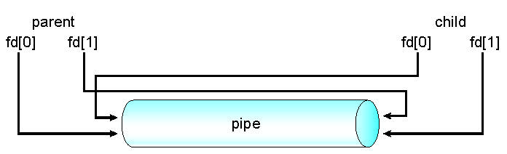
Ordinary Pipes
Ordinary Pipes allow communication in standard producer-consumer style
Producer writes to one end (the write-end of the pipe)
Consumer reads from the other end (the read-end of the pipe)
Ordinary pipes are therefore unidirectional
Require parent-child relationship between communicating processes
Windows calls these anonymous pipes
See Unix and Windows code samples in textbook
Courtesy : Abraham Silberschatz, Peter Baer Galvin, Greg Gagne, Operating systems, 9th ed., John Wiley & Sons, 2013

Slide 104

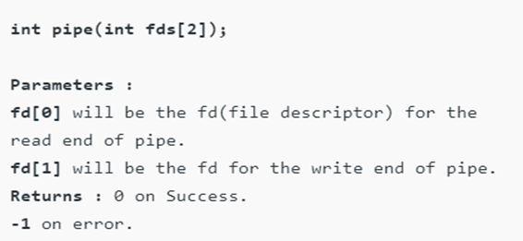
Ordinary Pipes
This system call would create a pipe for one-way communication
It creates two descriptors,
First one is connected to read from the pipe and
Other one is connected to write into the pipe
Descriptor pipedes[0] is for reading and pipedes[1] is for writing.
Whatever is written into pipedes[1] can be read from pipedes[0].
This call would return zero on success and -1 in case of failure.
Cannot be accessed from outside the process that creates it.
A parent process creates a pipe and uses it to communicate with a child process it creates via fork().
The child process inherits open files from its parent.
A pipe is a special type of file, the child inherits the pipe from its parent process.
Courtesy : Abraham Silberschatz, Peter Baer Galvin, Greg Gagne, Operating systems, 9th ed., John Wiley & Sons, 2013

Slide 105
Named Pipes
Named Pipes are more powerful than ordinary pipes
Communication is bidirectional
No parent-child relationship is necessary between the communicating processes
Several processes can use the named pipe for communication
Provided on both UNIX and Windows systems
Courtesy : Abraham Silberschatz, Peter Baer Galvin, Greg Gagne, Operating systems, 9th ed., John Wiley & Sons, 2013

Slide 106
Process Synchronization
Process Synchronization means sharing system resources by processes in a such a way that, Concurrent access to shared data is handled thereby minimizing the chance of inconsistent data.
Maintaining data consistency demands mechanisms to ensure synchronized execution of cooperating processes.
Process Synchronization was introduced to handle problems that arose while multiple process executions
Background
Processes can execute concurrently
May be interrupted at any time, partially completing execution
Concurrent access to shared data may result in data inconsistency
Maintaining data consistency requires mechanisms to ensure the orderly execution of cooperating processes
Illustration of the problem: Suppose that we wanted to provide a solution to the consumer-producer problem that fills all the buffers. We can do so by having an integer counter that keeps track of the number of full buffers. Initially, counter is set to 0. It is incremented by the producer after it produces a new buffer and is decremented by the consumer after it consumes a buffer.
Courtesy : Abraham Silberschatz, Peter Baer Galvin, Greg Gagne, Operating systems, 9th ed., John Wiley & Sons, 2013

Slide 107
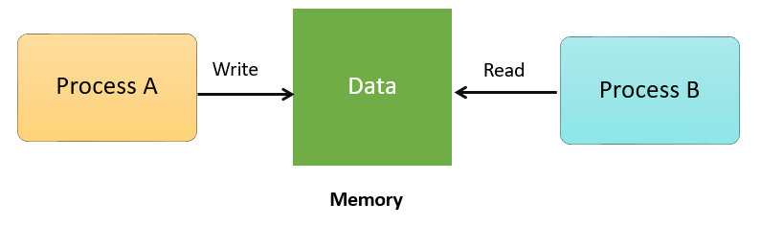
Need for Process Synchronization & Race Condition
Race condition: The situation where several processes access – and manipulate shared data concurrently.
The final value of the shared data depends upon which process finishes last.
It is coordinating the execution of processes , no two processes can have access to the same shared data and resources

Slide 108
Need for Process Synchronization & Race Condition
Race condition: The situation where several processes access – and manipulate shared data concurrently.
The final value of the shared data depends upon which process finishes last.
To prevent race conditions, concurrent processes must be synchronized.

Slide 109
Producer
Process Synchronization - Example
Consumer
while (true) { /* produce an item in next produced */
while (counter == BUFFER_SIZE) ;
/* do nothing */
buffer[in] = next_produced;
in = (in + 1) % BUFFER_SIZE;
counter++;
}
while (true) {
while (counter == 0)
; /* do nothing */
next_consumed = buffer[out];
out = (out + 1) % BUFFER_SIZE;
counter--;
/* consume the item in next consumed */
}
Courtesy : Abraham Silberschatz, Peter Baer Galvin, Greg Gagne, Operating systems, 9th ed., John Wiley & Sons, 2013

Slide 110
Race Condition
counter++ could be implemented as register1 = counter register1 = register1 + 1 counter = register1
counter-- could be implemented as register2 = counter register2 = register2 - 1 counter = register2
Consider this execution interleaving with “count = 5” initially:
S0: producer execute register1 = counter {register1 = 5} S1: producer execute register1 = register1 + 1 {register1 = 6} S2: consumer execute register2 = counter {register2 = 5} S3: consumer execute register2 = register2 – 1 {register2 = 4} S4: producer execute counter = register1 {counter = 6 } S5: consumer execute counter = register2 {counter = 4}
Courtesy : Abraham Silberschatz, Peter Baer Galvin, Greg Gagne, Operating systems, 9th ed., John Wiley & Sons, 2013

Slide 111
Critical Section Problem
Consider system of n processes {p₀, p₁, … p_{n-1}}
Each process has critical section segment of code
Process may be changing common variables, updating table, writing file, etc
When one process in critical section, no other may be in its critical section
critical section – segment of code that access/modify shared data resources.
In the critical section, only a single process can be executed.
Other processes, waiting to execute their critical section, need to wait until the current process completes its execution.

Slide 112
Sections of a Program
Entry Section: Decides the entry of a particular process.
Critical Section: Allows one process to enter and modify the shared variable.
Exit Section: Allows the other process that are waiting in the Entry Section, to enter into the Critical Sections.
It also checks that a process that finished its execution should be removed through this Section.
Remainder Section: All other parts of the Code, which is not in Critical, Entry, and Exit Section, are known as the Remainder Section.

Slide 113
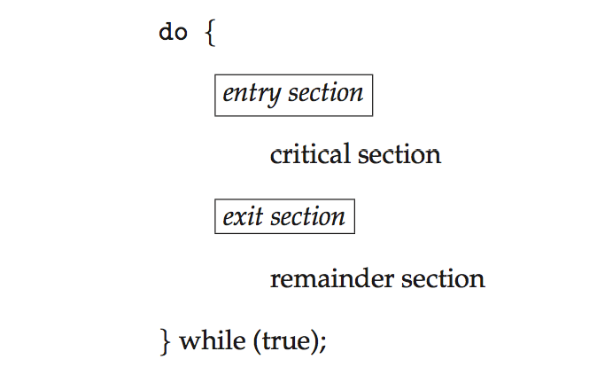
Critical Section
General structure of process P_{i}

Slide 114
Algorithm for Process P_{i}
do {
while (turn == j);
critical section
turn = j;
remainder section
} while (true);

Slide 115
Rules for Critical-Section Problem
1. Mutual Exclusion - If process P_{i} is executing in its critical section, then no other processes can be executing in their critical sections
2. Progress - If no process is executing in its critical section and some Process wants in. Then those processes not in their reminder section should decide who should go in, in a finite time.
3. Bounded Waiting - A bound must exist on the number of times that other processes are allowed to enter their critical sections after a process has made a request to enter its critical section and before that request is granted
Assume that each process executes at a nonzero speed
No assumption concerning relative speed of the n processes

Slide 116
Solutions To The Critical Section
1. Peterson Solution - when a process is executing in a critical state, then the other process only executes the rest of the code
2. Synchronization Hardware - a Process acquires a lock when entering the Critical section and releases the lock after leaving it.
Mutex Locks - In the entry section of code, a LOCK is obtained over the critical resources used inside the critical section. In the exit section that lock is released.
Semaphore Solution - Semaphore is a variable that is non-negative and shared between threads. It is a signaling mechanism and a thread that is waiting on a semaphore, which can be signaled by another thread.

